Slide 1
Chapter 5 Coding and Error Control
Mohammed Abdalla Youssif
1

Slide 2
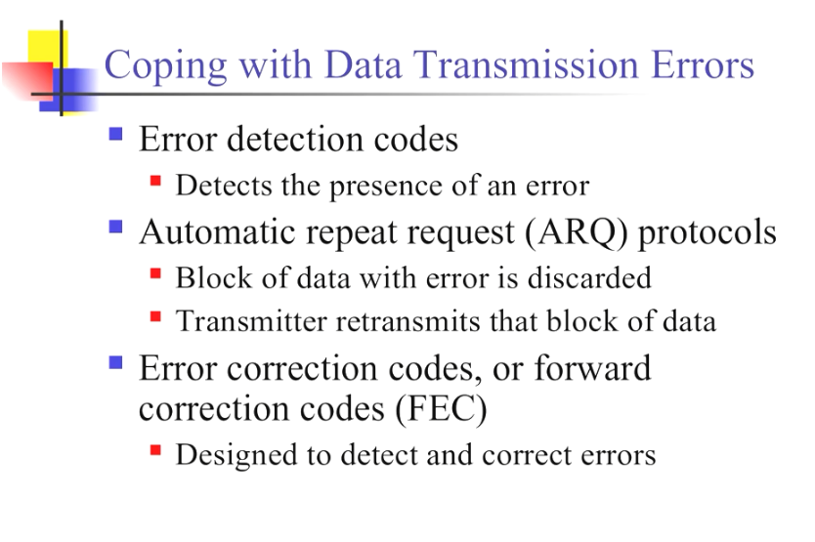
Chapter 5 Coding and Error Control
Mohammed Abdalla Youssif
2

Slide 3
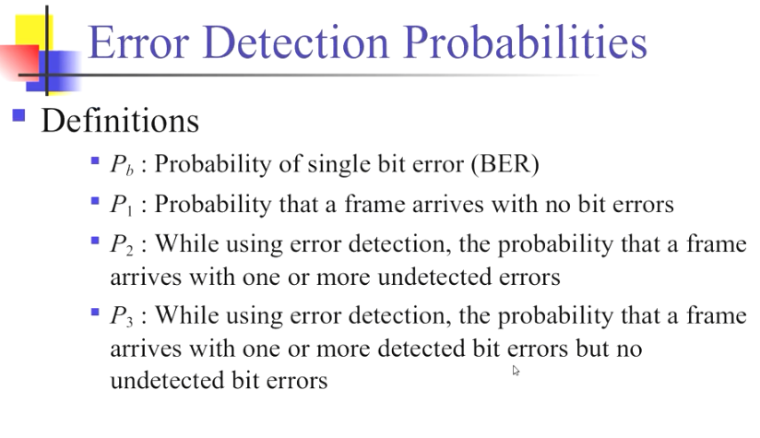
Chapter 5 Coding and Error Control
Mohammed Abdalla Youssif
3

Slide 4
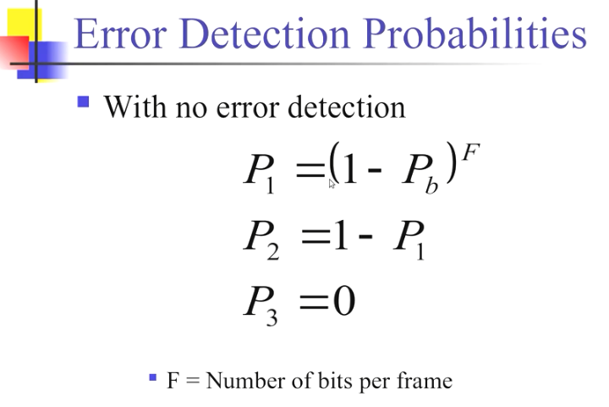
Chapter 5 Coding and Error Control
Mohammed Abdalla Youssif
4

Slide 5
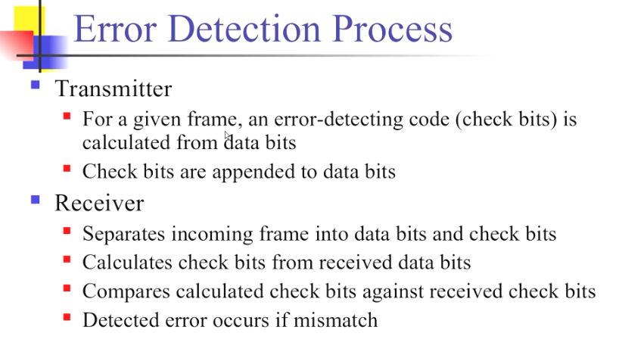
5

Slide 6
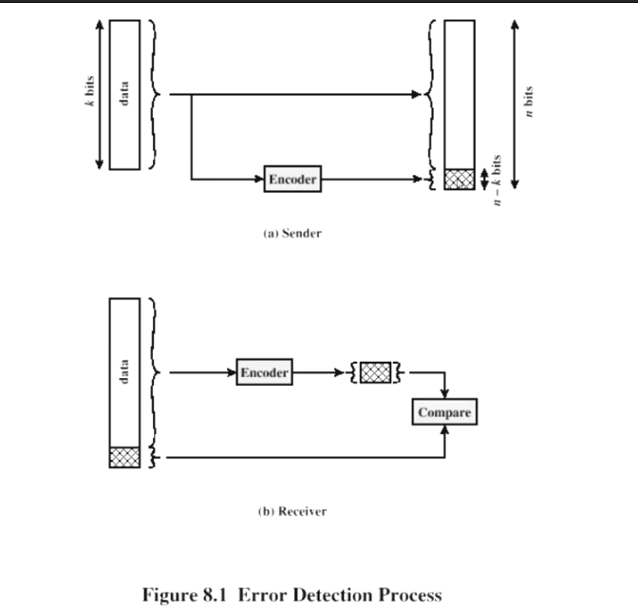
6

Slide 7
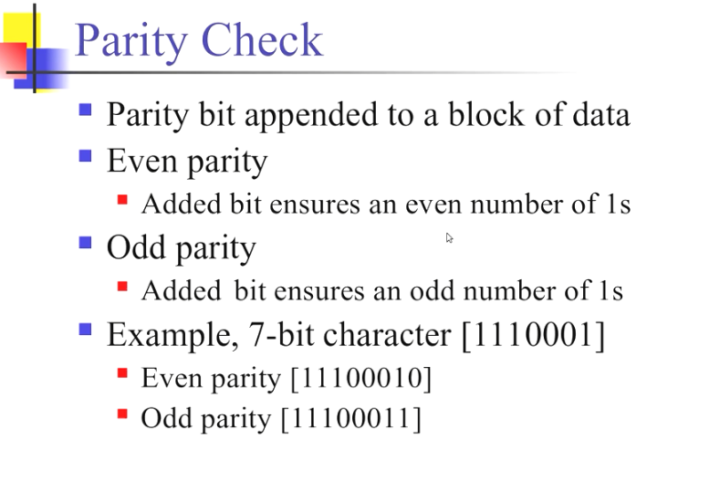
7

Slide 8
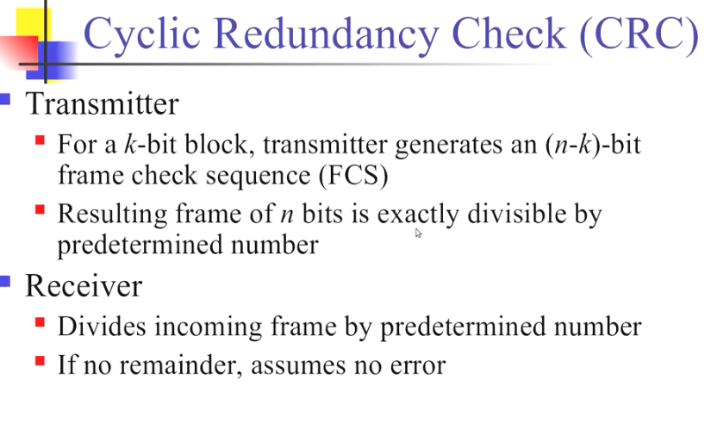
8

Slide 9
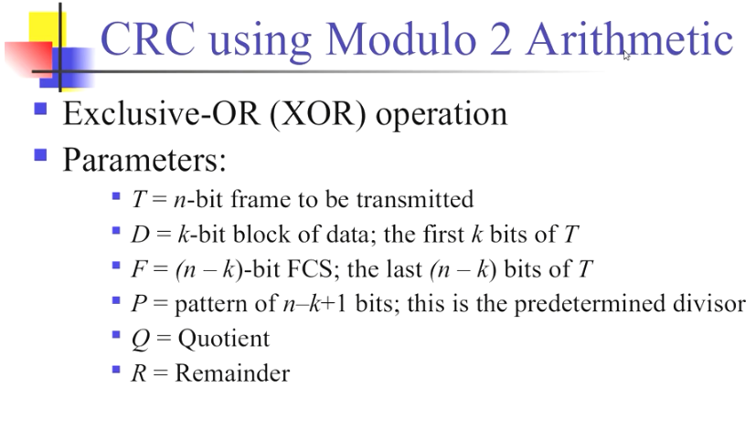
9

Slide 10
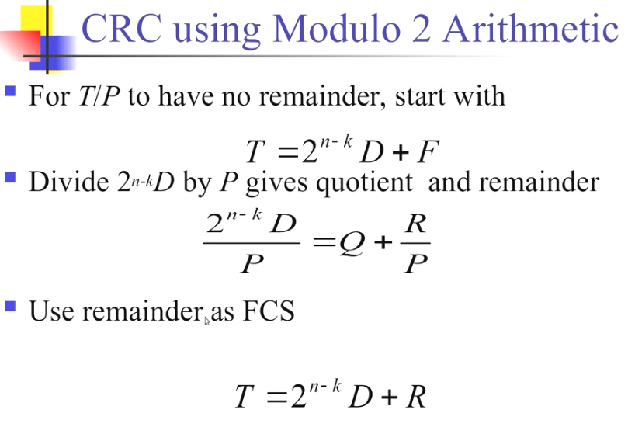
10

Slide 11
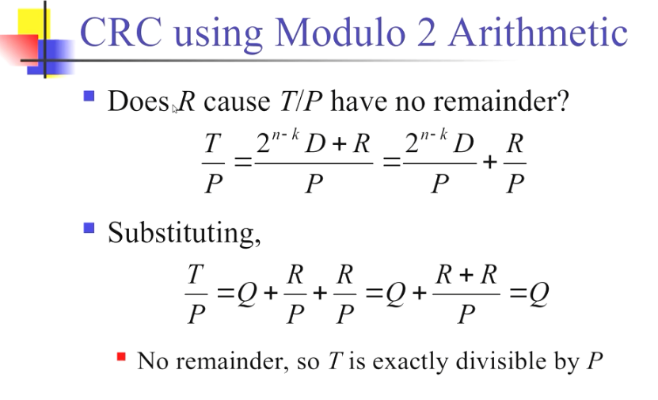
11

Slide 12
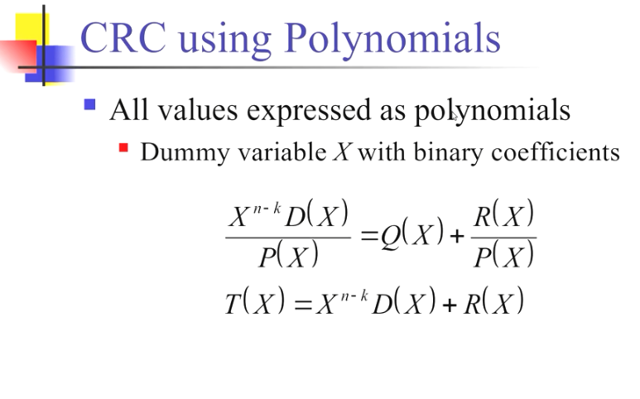
12

Slide 13
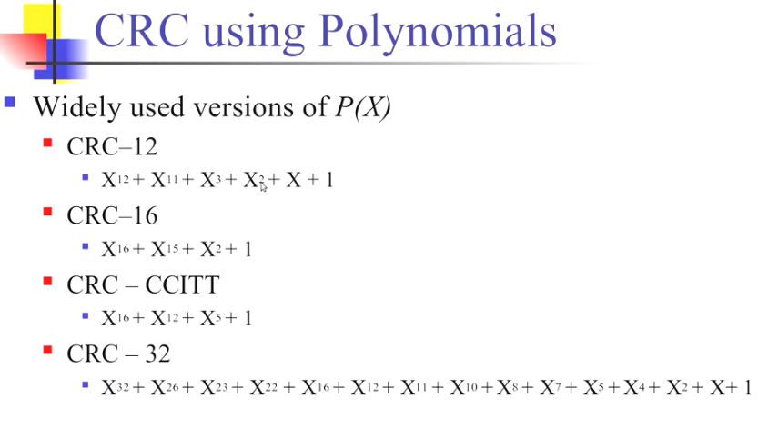
13

Slide 14
14

Slide 15
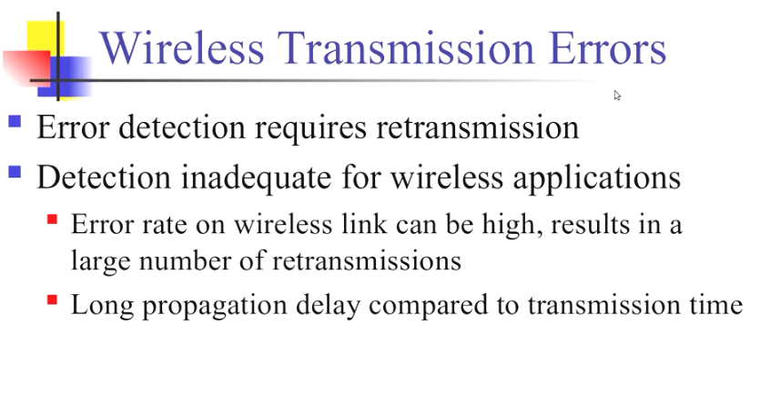
15

Slide 16
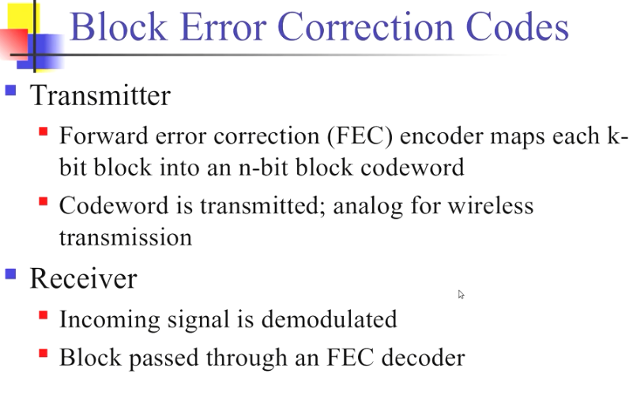
16

Slide 17
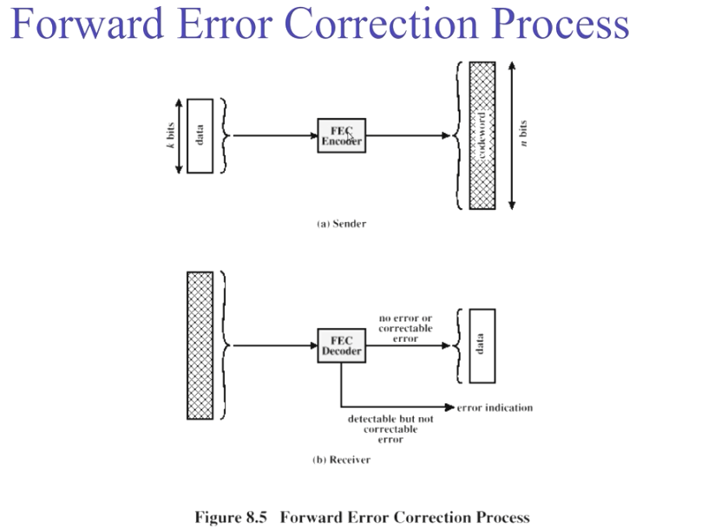
17

Slide 18
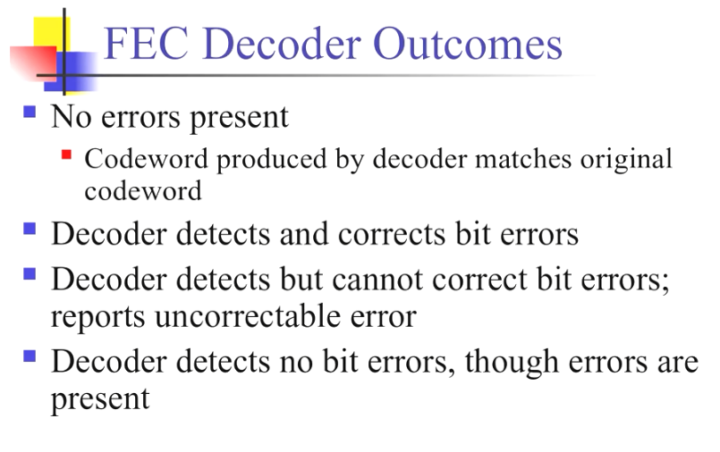
18

Slide 19
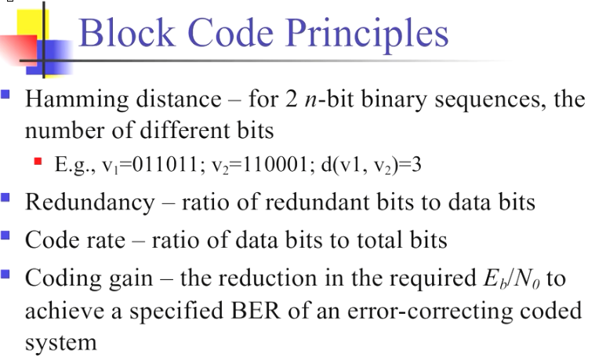
19

Slide 20
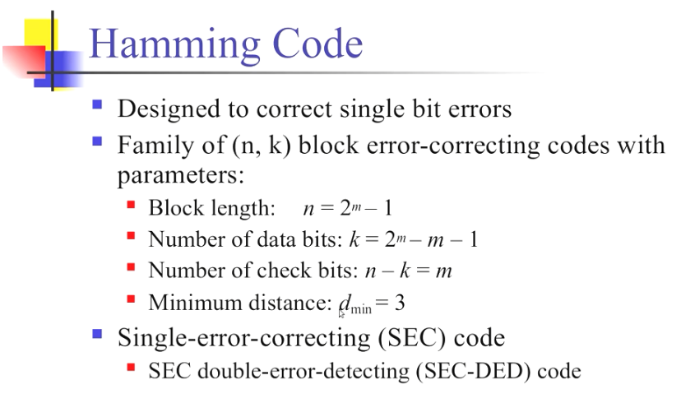
20

Slide 21
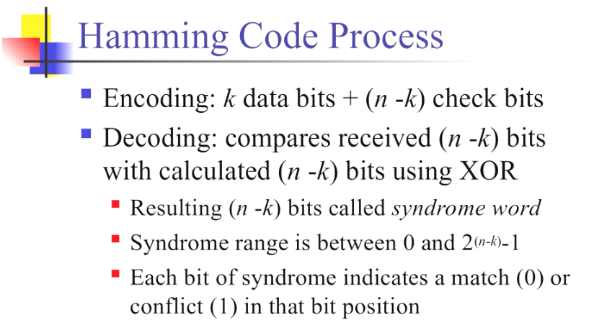
21

Slide 22
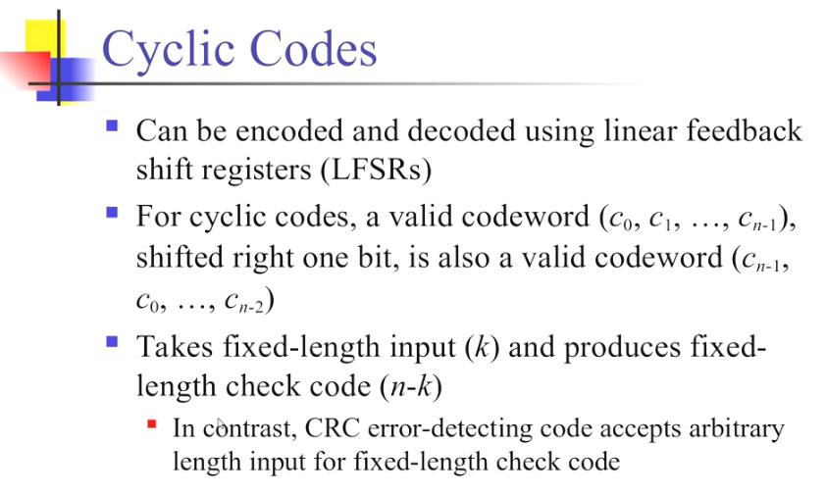
22

Slide 23
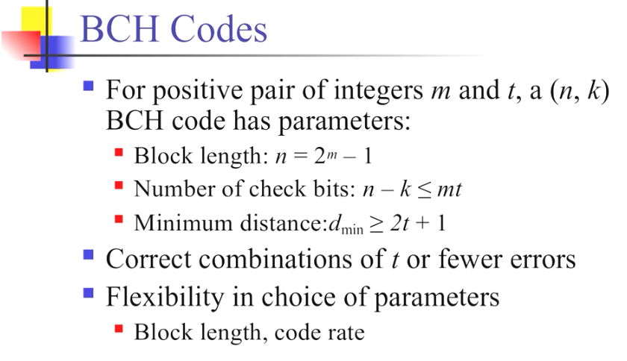
23

Slide 24
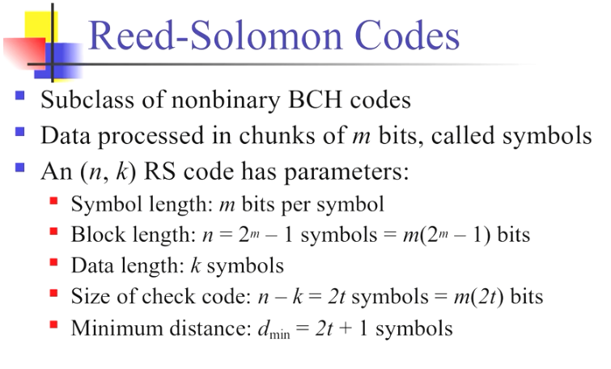
24

Slide 25
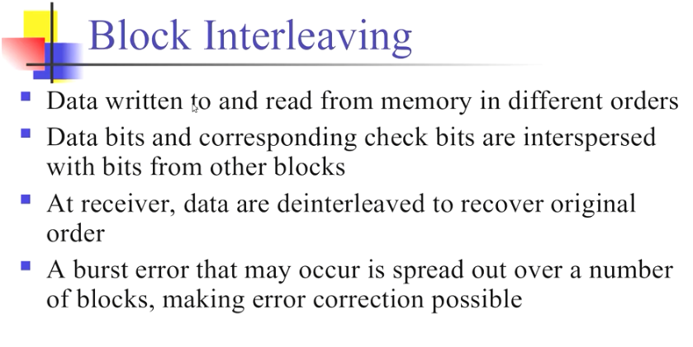
25

Slide 26
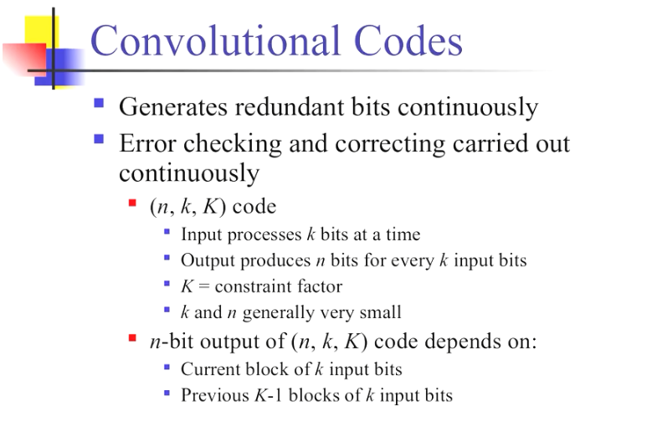
26

Slide 27
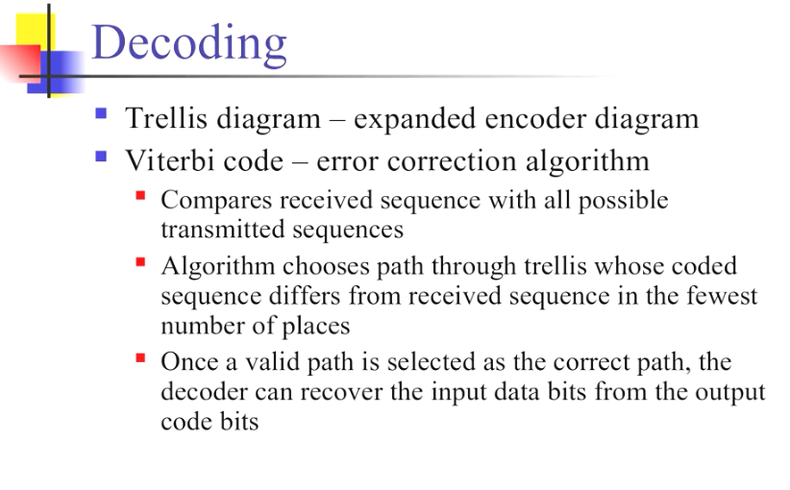
27

Slide 28
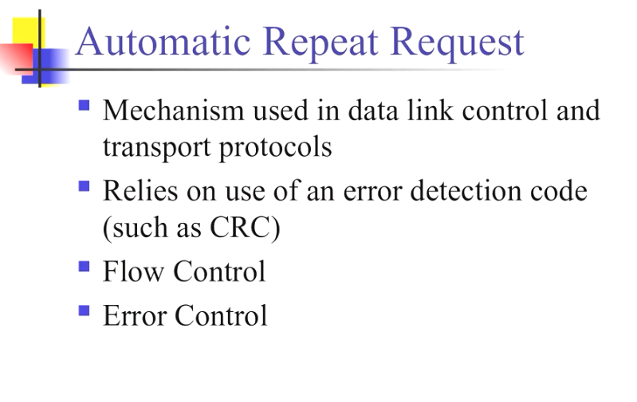
28

Slide 29
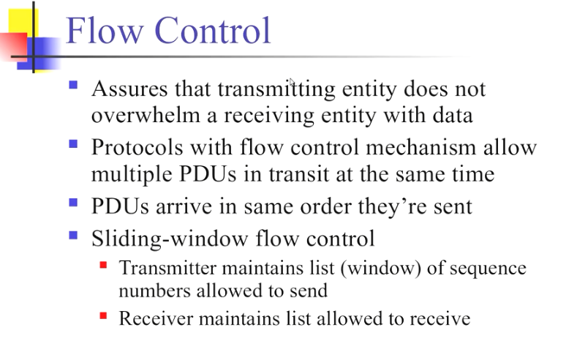
29

Slide 30
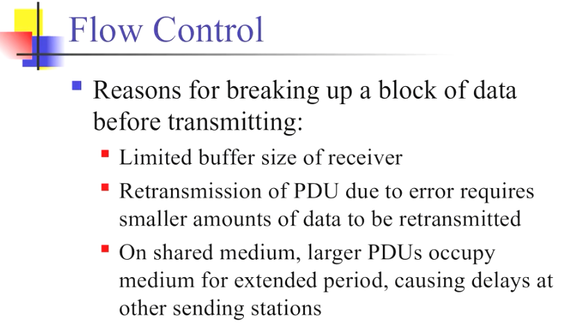
30

Slide 31
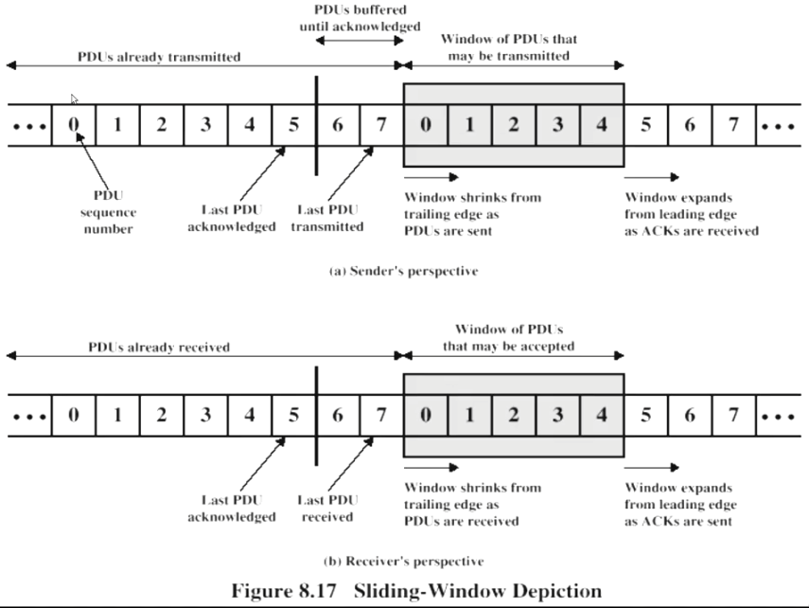
31

Slide 32
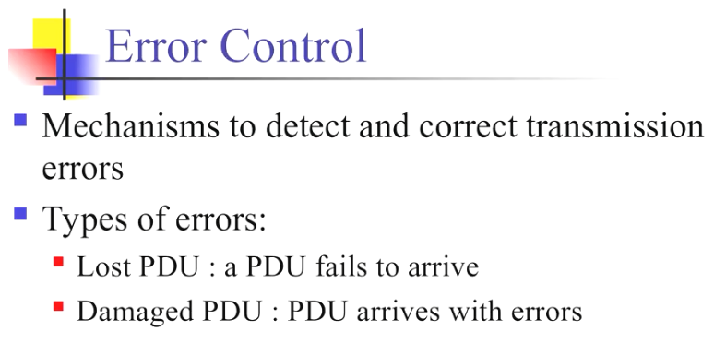
32

Slide 33
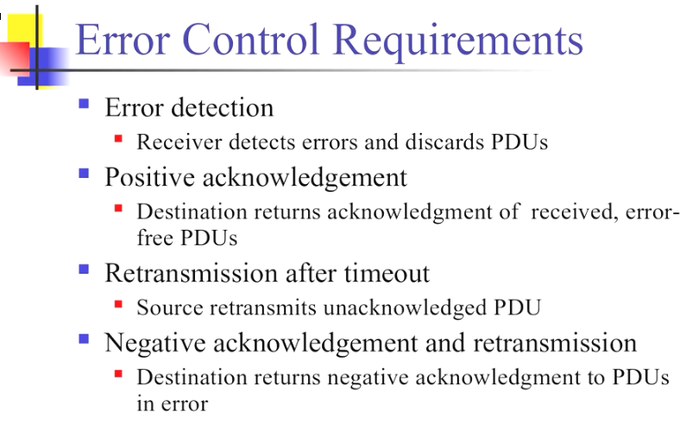
33

Slide 34
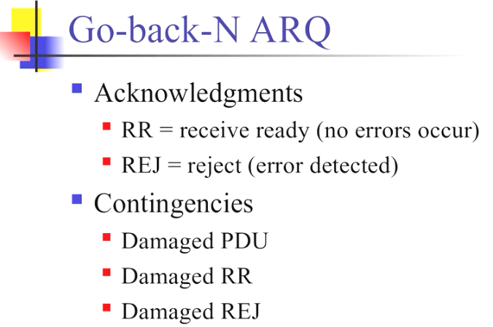
34

Slide 35
Go-Back-N ARQ Cont.
Go-Back-N ARQ is a specific instance of the automatic repeat request (ARQ) protocol, in which the sending process continues to send a number of frames specified by a window size even without receiving an acknowledgement (ACK) packet from the receiver. It is a special case of the general sliding window protocol with the transmit window size of N and receive window size of 1. It can transmit N frames to the peer before requiring an ACK.

Slide 36
Go-Back-N ARQ Cont.
The receiver process keeps track of the sequence number of the next frame it expects to receive. It will discard any frame that does not have the exact sequence number it expects (either a duplicate frame it already acknowledged, or an out-of-order frame it expects to receive later) and will send an ACK for the last correct in-order frame. Once the sender has sent all of the frames in its window, it will detect that all of the frames since the first lost frame are outstanding, and will go back to the sequence number of the last ACK it received from the receiver process and fill its window starting with that frame and continue the process over again.
The negative-acknowledgement (NAK or NACK) signal is sent to reject a previously received message or to indicate some kind of error.

Slide 37
Questions ?
37
Notes:
37

